Slide 1
JavaScript

Slide 2
Control structure / Conditional Statements
Conditional statements - used to perform different action based on different conditions.
If statement
If…else statement
If…else…if… statement
Switch Case

Slide 3
The if Statement
It is the fundamental control statement that allows javaScript to make decision and execute statements conditionally.
If(expression)
{
statements to be executed if expression is true
}
If the resulting value is true, given statements are executed.
If the expression is false then no statement would be executed.

Slide 4
The else Statement
if (condition)
{ block of code to be executed if the condition is true }
else
{ block of code to be executed if the condition is false }

Slide 5
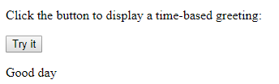
Example
<html>
<body>
<p>Click the button to display a time-based greeting:</p>
<button onclick="myFunction()">Try it</button>
<p id="demo"></p>
<script>
function myFunction() {
var hour = new Date().getHours();
var greeting;
if (hour < 18) {
greeting = "Good day";
} else {
greeting = "Good evening";
}
document.getElementById("demo").innerHTML = greeting;
}
</script>
</body>
</html>

Slide 6
The else if Statement
if (condition1)
{ block of code to be executed if condition1 is true }
else if (condition2)
{ block of code to be executed if the condition1 is false and condition2 is true }
Else
{ block of code to be executed if the condition1 is false and condition2 is false }

Slide 7
Example
<html>
<body>
<p>Click the button to get a time-based greeting:</p>
<button onclick="myFunction()">Try it</button>
<p id="demo"></p>
<script>
function myFunction() {
var greeting;
var time = new Date().getHours();
if (time < 10) {
greeting = "Good morning";
} else if (time < 20) {
greeting = "Good day";
} else {
greeting = "Good evening";
}
document.getElementById("demo").innerHTML = greeting;
}
</script>
</body>
</html>

Slide 8
Switch Statement
switch(expression)
{ case n: code block break; case n: code block break; default: code block }
1. The switch expression is evaluated once.
2. The value of the expression is compared
with the values of each case.
3. If there is a match, the associated block of
code is executed.

Slide 9

Example
<html>
<body>
<p id="demo"></p>
<script>
var day;
switch (new Date().getDay()) {
case 0:
day = "Sunday";
break;
case 1:
day = "Monday";
break;
case 2:
day = "Tuesday";
break;
case 3:
day = "Wednesday";
break;
case 4:
day = "Thursday";
break;
case 5:
day = "Friday";
break;
case 6:
day = "Saturday";
}
document.getElementById("demo").innerHTML = "Today is " + day;
</script>
</body>
</html>

Slide 10
The break Keyword
When JavaScript reaches a break keyword, it breaks out of the switch block.
This will stop the execution of more code and case testing inside the block.
When a match is found, and the job is done, it's time for a break. There is no need for more testing.
A break can save a lot of execution time because it "ignores" the execution of all the rest of the code in the switch block.
It is not necessary to break the last case in a switch block. The block breaks (ends) there anyway.

Slide 11

The default Keyword
<html>
<body>
<p id="demo"></p>
<script>
var text;
switch (new Date().getDay()) {
case 6:
text = "Today is Saturday";
break;
case 0:
text = "Today is Sunday";
break;
default:
text = "Looking forward to the Weekend";
}
document.getElementById("demo").innerHTML = text;
</script>
</body>
</html>

Slide 12
Default Not last case
<html>
<body>
<p id="demo"></p>
<script>
var text;
switch (new Date().getDay()) {
default:
text = "Looking forward to the Weekend";
break;
case 6:
text = "Today is Saturday";
break;
case 0:
text = "Today is Sunday";
}
document.getElementById("demo").innerHTML = text;
</script>
</body>
</html>

Slide 13
JavaScript Loops
JavaScript supports different kinds of loops:
for - loops through a block of code a number of times
for/in - loops through the properties of an object
while - loops through a block of code while a specified condition is true
do/while - also loops through a block of code while a specified condition is true

Slide 14
The For Loop
The for loop is often the tool you will use when you want to create a loop.
The for loop has the following syntax:
for (statement 1; statement 2; statement 3)
{ code block to be executed }
Statement 1 :executed before the loop (the code block) starts.
Statement 2 :defines the condition for running the loop (the
code block).
Statement 3 :executed each time after the loop (the code
block) has been executed.

Slide 15
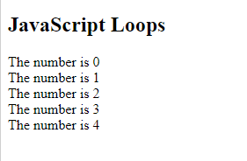
Example
<html>
<body>
<h2>JavaScript Loops</h2>
<p id="demo"></p>
<script>
var text = "";
var i;
for (i = 0; i < 5; i++) {
text += "The number is " + i + "<br>";
}
document.getElementById("demo").innerHTML = text;
</script>
</body>
</html>

Slide 16
The While Loop
while (condition)
{ code block to be executed }

Slide 17
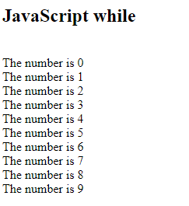
Example
<html>
<body>
<h2>JavaScript while</h2>
<p id="demo"></p>
<script>
var text = "";
var i = 0;
while (i < 10) {
text += "<br>The number is " + i;
i++;
}
document.getElementById("demo").innerHTML = text;
</script>
</body>
</html>

Slide 18
The Do/While Loop
do
{ code block to be executed }while (condition);

Slide 19
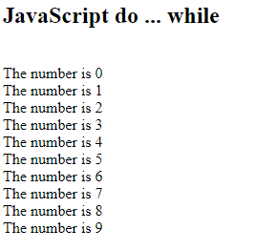
Example
<html>
<body>
<h2>JavaScript do ... while</h2>
<p id="demo"></p>
<script>
var text = ""
var i = 0;
do {
text += "<br>The number is " + i;
i++;
}
while (i < 10);
document.getElementById("demo").innerHTML = text;
</script>
</body>
</html>

Slide 20
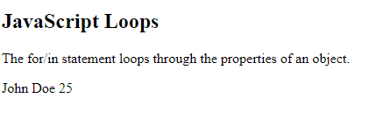
The For/In Loop
<html>
<body>
<h2>JavaScript Loops</h2>
<p>The for/in statement loops through the properties of an object.</p>
<p id="demo"></p>
<script>
var txt = "";
var person = {fname:"John", lname:"Doe", age:25};
var x;
for (x in person) {
txt += person[x] + " ";
}
document.getElementById("demo").innerHTML = txt;
</script>
</body>
</html>

Slide 21
JavaScript Popup Boxes
JavaScript has three kind of popup boxes:
1. Alert box,
2. Confirm box, and
3. Prompt box.

Slide 22
Alert Box
An alert box is often used if you want to make sure information comes through to the user.
When an alert box pops up, the user will have to click "OK" to proceed.
Syntax
window.alert("sometext"); or
alert(“sometext”);
The window.alert() method can be written without the window prefix.

Slide 23
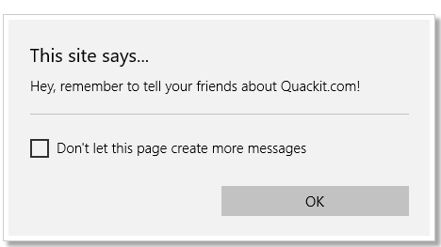
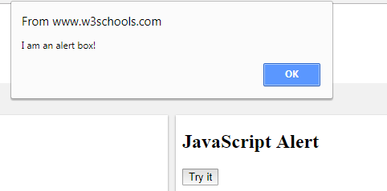
Example
<html>
<body>
<h2>JavaScript Alert</h2>
<button onclick="myFunction()">Try it</button>
<script>
function myFunction() {
alert("I am an alert box!");
}
</script>
</body>
</html>

Slide 24
Confirm Box
A confirm box is often used if you want the user to verify or accept something.
When a confirm box pops up, the user will have to click either "OK" or "Cancel" to proceed.
If the user clicks "OK", the box returns true. If the user clicks "Cancel", the box returns false.
Syntax
window.confirm("sometext"); or confirm("sometext");
The window.confirm() method can be written without the window prefix.

Slide 25
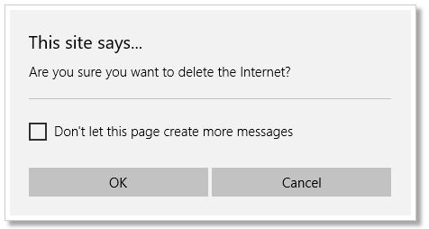
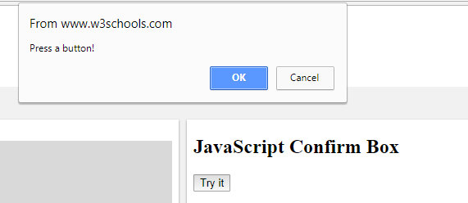
Example
<html>
<body>
<h2>JavaScript Confirm Box</h2>
<button onclick="myFunction()">Try it</button>
<p id="demo"></p>
<script>
function myFunction() {
var txt;
if (confirm("Press a button!")) {
txt = "You pressed OK!";
} else {
txt = "You pressed Cancel!";
}
document.getElementById("demo").innerHTML = txt;
}
</script>
</body>
</html>

Slide 26
Prompt Box
A prompt box is often used if you want the user to input a value before entering a page.
When a prompt box pops up, the user will have to click either "OK" or "Cancel" to proceed after entering an input value.
If the user clicks "OK" the box returns the input value. If the user clicks "Cancel" the box returns null.
Syntax
window.prompt("sometext","defaultText");
The window.prompt() method can be written without the window prefix.

Slide 27
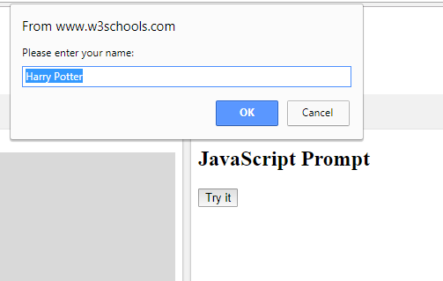
Example
document.getElementById("demo").innerHTML = txt;
}
</script>
</body>
</html>
<html>
<body>
<h2>JavaScript Prompt</h2>
<button onclick="myFunction()">Try it</button>
<p id="demo"></p>
<script>
function myFunction() {
var txt;
var person = prompt("Please enter your name:", "Harry Potter");
if (person == null || person == "") {
txt = "User cancelled the prompt.";
} else {
txt = "Hello " + person + "! How are you today?";
}

Slide 28
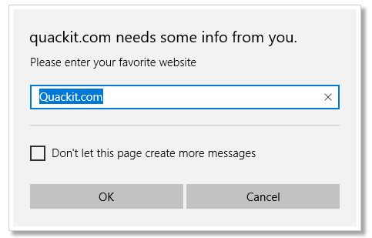

Slide 29
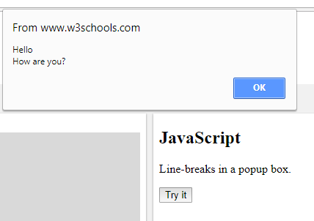
Line Breaks
To display line breaks inside a popup box, use a back-slash followed by the character n.
<html>
<body>
<h2>JavaScript</h2>
<p>Line-breaks in a popup box.</p>
<button onclick="alert('Hello\nHow are you?')">Try it</button>
</body>
</html>

Slide 30
JavaScript and Object
Object :Data with Properties and methods.
Properties : Values associated with object
Methods : Action that objects can perform.
Classification
Built in Object
Browser Object
Dom Object

Slide 31
Built In Object
Accessible anywhere in program
Work same way in any browser running in any OS
Built in Objects are
Array Object
Boolean Object
Date Object
Math Object
Number Object
String Object
RegExp Object

Slide 32
Browser Object
Allows JS to “talk to” the browser
Browser Objects are:
Window Object
Navigator Object
Screen Object
History Object
Location Object

Slide 33
DOM Object
When web page is loaded, the browser creates a Document Object Model of the page.
DOM model is constructed as a tree of objects.
DOM objects are:
HTML Document
HTML Element
HTML Attributes
HTML Events

Slide 34
Built-In Object

Slide 35
Number Object
It is a wrapper object allowing user to work with primitive numerical values.
It represents numerical date, either int or float.
It is created using number() constructor.
Number Properties
It is read-only constants, means its values remain same.
Properties:
MAX_VALUE : Return largest possible value for number
MIN_VALUE: Return smallest possible value for number

Slide 36
Example
1.7976931348623157e+308
<html>
<body>
<p id="demo"></p>
<script>
document.getElementById("demo").innerHTML = Number.MAX_VALUE;
</script>
</body>
</html>

Slide 37
Number Method
toExponentials(x):
Convert number in an exponential notation.
toFixed(x):
Formats a number with x number of digits after decimal point.
ToPrecision(x):
Determines a significant digits to display.
toString(x):
Returns the string representation of number.
valueOf(x):
Returns the primitive value of a number object.

Slide 38
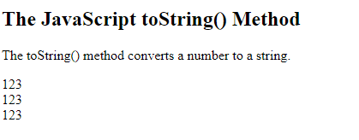
The toString() Method
toString() returns a number as a string.
All number methods can be used on any type of numbers (literals, variables, or expressions):
<html>
<body>
<h2>The JavaScript toString() Method</h2>
<p>The toString() method converts a number to a string.</p>
<p id="demo"></p>
<script>
var x = 123;
document.getElementById("demo").innerHTML =x.toString() + "<br>" +
(123).toString() + "<br>" +
(100 + 23).toString();
</script>
</body>
</html>

Slide 39
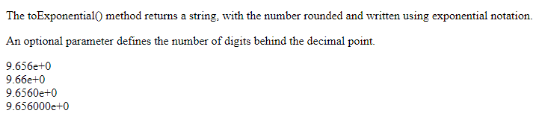
The toExponential() Method
toExponential() returns a string, with a number rounded and written using exponential notation.
A parameter defines the number of characters behind the decimal point:
<html>
<body>
<p>The toExponential() method returns a string, with the number rounded and written using exponential notation.</p>
<p>An optional parameter defines the number of digits behind the decimal point.</p>
<p id="demo"></p>
<script>
var x = 9.656;
document.getElementById("demo").innerHTML =
x.toExponential() + "<br>" +
x.toExponential(2) + "<br>" +
x.toExponential(4) + "<br>" +
x.toExponential(6);
</script>
</body>
</html>

Slide 40
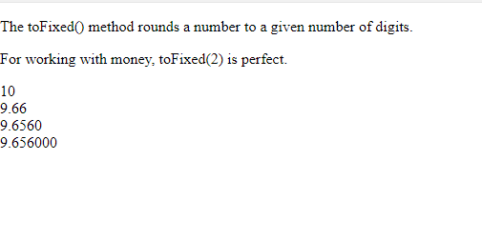
The toFixed() Method
toFixed() returns a string, with the number written with a specified number of decimals:
<html>
<body>
<p>The toFixed() method rounds a number to a given number of digits.</p>
<p>For working with money, toFixed(2) is perfect.</p>
<p id="demo"></p>
<script>
var x = 9.656;
document.getElementById("demo").innerHTML =
x.toFixed(0) + "<br>" +
x.toFixed(2) + "<br>" +
x.toFixed(4) + "<br>" +
x.toFixed(6);
</script>
</body>
</html>

Slide 41
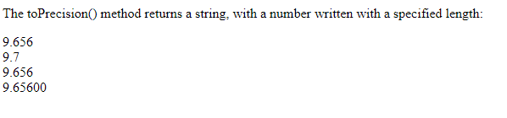
The toPrecision() Method
toPrecision() returns a string, with a number written with a specified length:
<html>
<body>
<p>The toPrecision() method returns a string, with a number written with a specified length:</p>
<p id="demo"></p>
<script>
var x = 9.656;
document.getElementById("demo").innerHTML =
x.toPrecision() + "<br>" +
x.toPrecision(2) + "<br>" +
x.toPrecision(4) + "<br>" +
x.toPrecision(6);
</script>
</body>
</html>

Slide 42
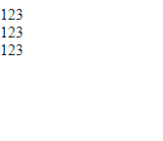
The valueOf() Method
valueOf() returns a number as a number.
<html>
<body>
<p id="demo"></p>
<script>
var x = 123;
document.getElementById("demo").innerHTML =
x.valueOf() + "<br>" +
(123).valueOf() + "<br>" +
(100 + 23).valueOf();
</script>
</body>
</html>

